Slide 1
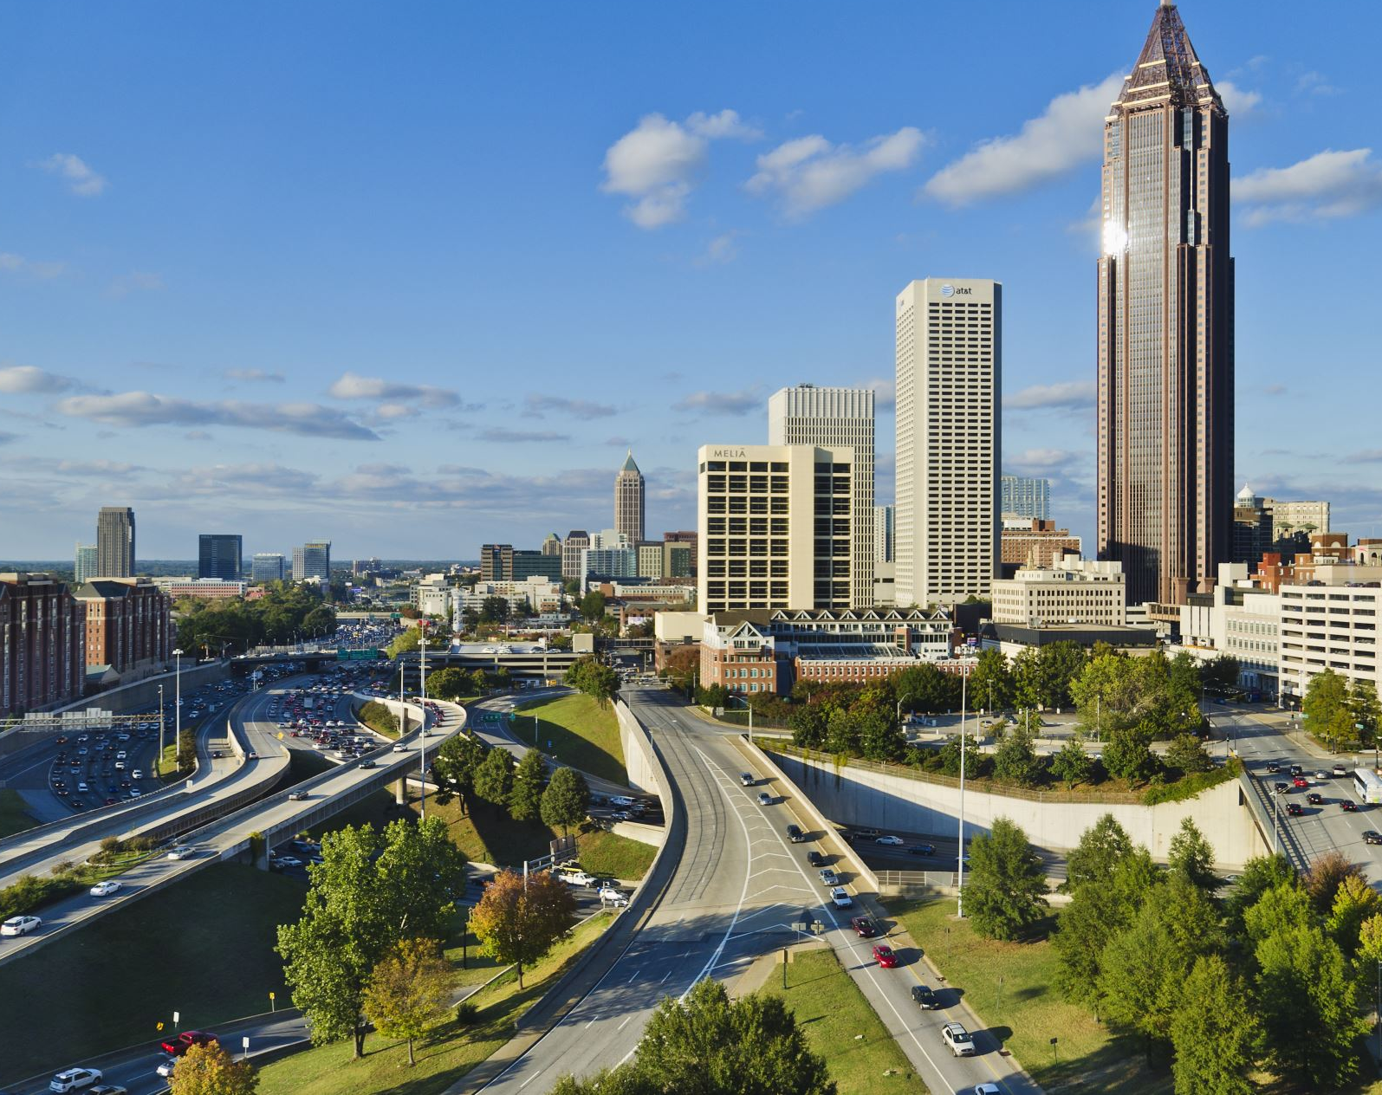
Creating Utopia
The Design of a Better Future
Urban Studies 12

Slide 2
Cities are for People; Cities are Beautiful
What are the six steps to a beautiful city?
Do you agree or disagree with the concepts presented?

Slide 3
Vancouver – Most Beautiful People City?
Why is Vancouver always as one of the top cities to live in compared to the rest of the world?
How did city planning make this possible?
What struggles does Vancouver still have to overcome?

Slide 4
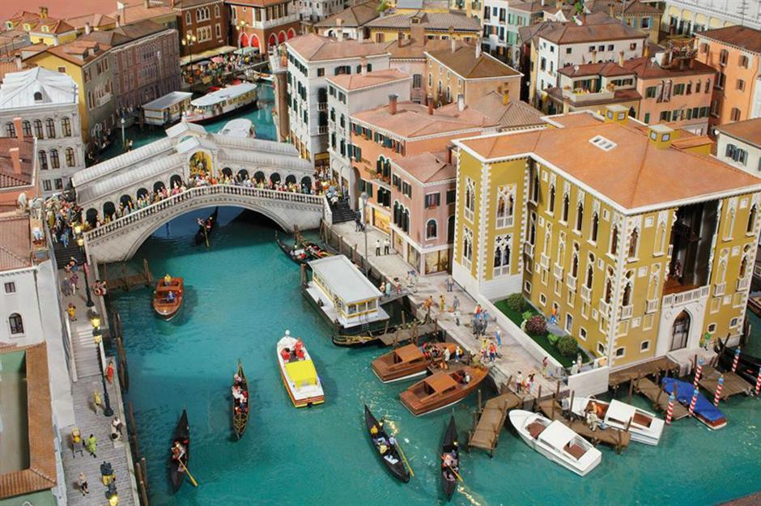
The Design of a City...

